Slide 1
Meta Learning

Slide 2

Current methods
obtaining a good performance on a test set that had similar data.
what if:
the test set has classes that we do not have in the training set
2. we want to test the model on a completely different task

Slide 3
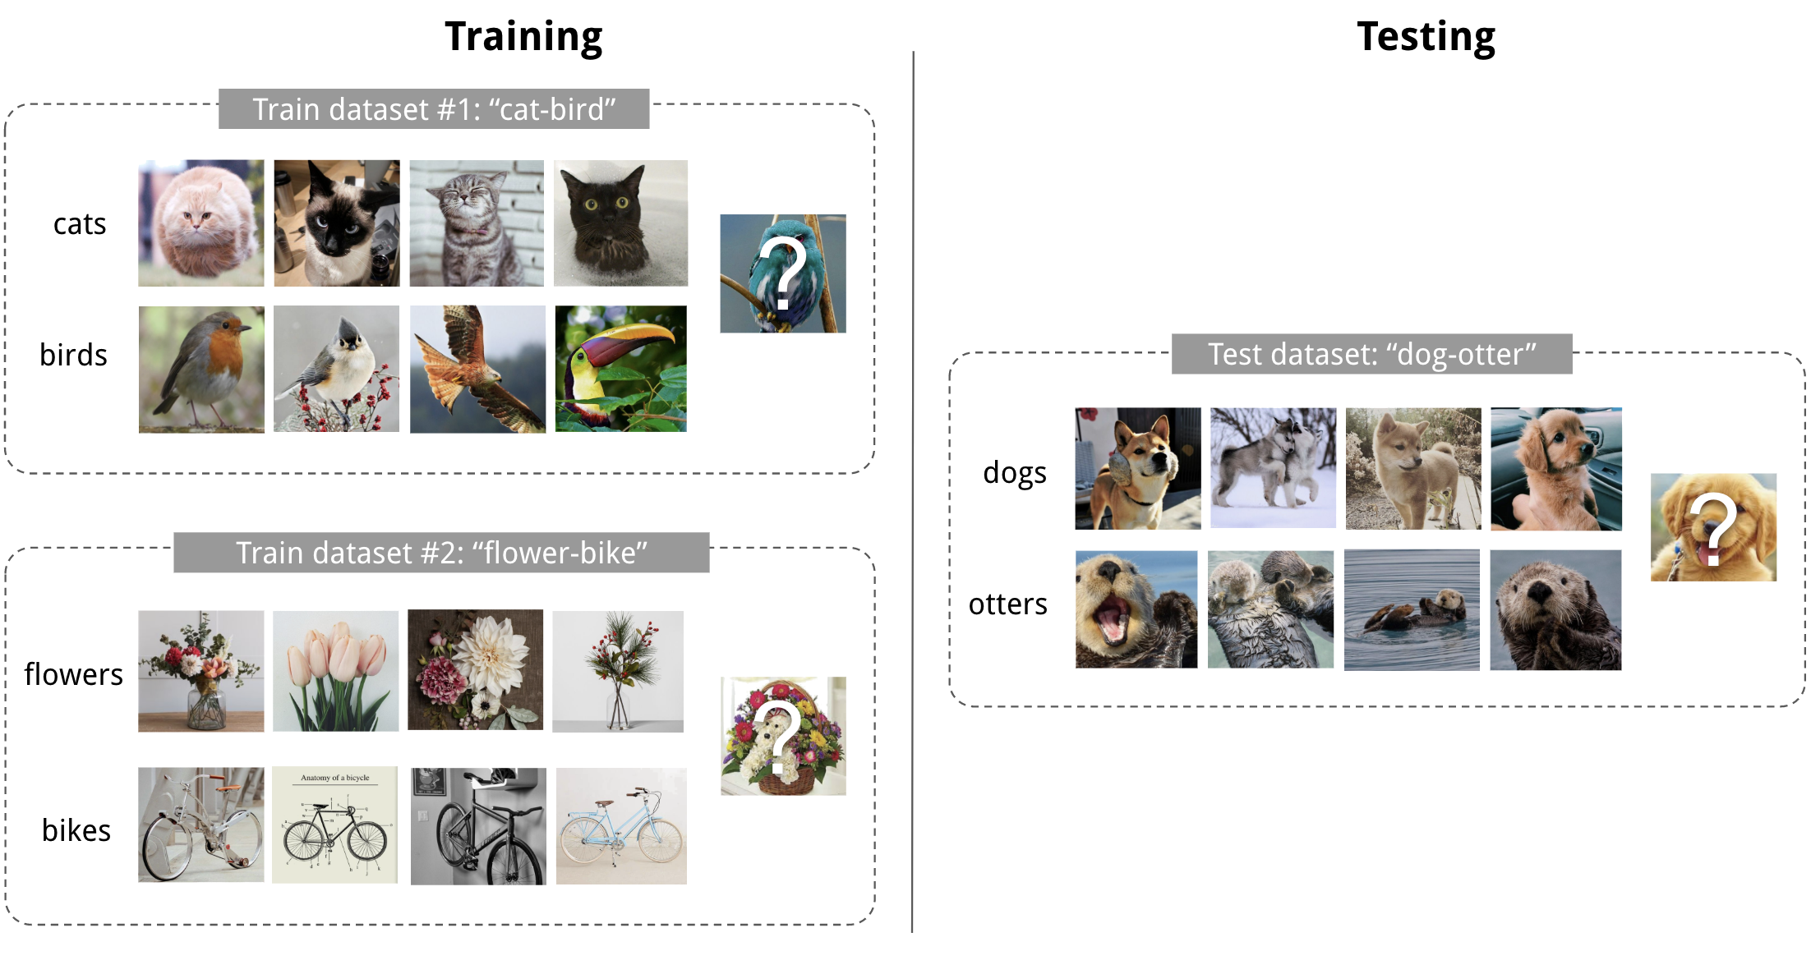
Example

Slide 4
few-shot classification
a task to distinguish between M novel classes.
not only have novel classes, but also a completely different dataset.

Slide 5
Time Series Data Sets with Metric Based Few Shot Learning

Slide 6
Presentation Outline
A general introduction into few shot learning followed by a specific use case:
Motivation
Data-driven models
Data-driven models for data-limitations
Few shot learning
Few shot learning for time series classification
How can this be advantageous for our use cases?
Proof of concept
Conclusion

Slide 7
1. Motivation
Repetitive data analysis goals in maintenance systems:
Goals: Find dependencies, Failure prediction, Anomaly Detection
Data types: Time series
Difficulties: Data limitation due to lack of disastrous events, Data quality

Slide 8
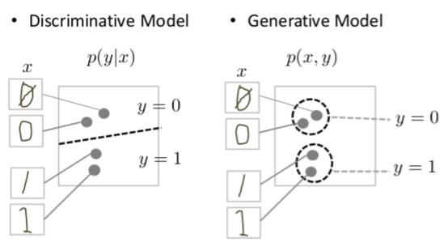
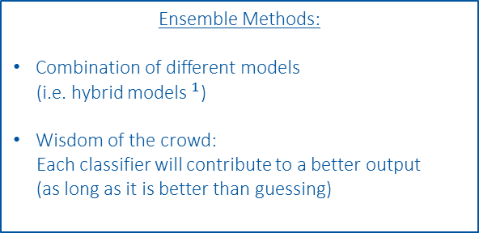
2. Overview of Data-Driven Models
High incorporation of knowledge and context
Data-Driven Models
Manual Feature Engineering
Manual Threshold
Probabilistic
Classic Machine Learning
Automatic Feature Eningeering
Disciminative Deep Learning
Generative Deep Learning
GAN, RNN, ProtoNET
MLP, DCNN, FCN
SVM, Random Forrest, MLP
e.g. Busbar Resistance
e.g. QH Analysis
Fully data driven
Physical Models
Ensemble Methods:
Combination of different models
(i.e. hybrid models$^{1}$)
Wisdom of the crowd:
Each classifier will contribute to a better output
(as long as it is better than guessing)
Discriminative:
Output:
Conditional probability:
p(Output | Input)
Threshold is adjusted
based on model
Generative:
Output:
Joint probability
p(Output, Input)
Clustering as a Prestep

Slide 9
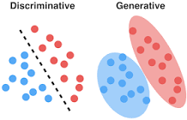
Discriminative v.s. generative models
Discriminative models draw boundaries in the data space
generative models try to model how data is placed throughout the space.
A generative model focuses on explaining how the data was generated, while a discriminative model focuses on predicting the labels of the data.

Slide 10
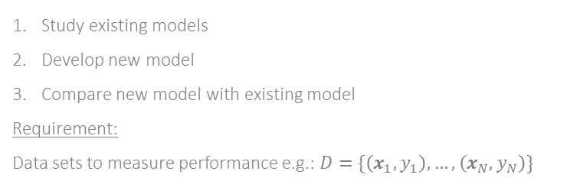
2. Overview of Data-Driven Models
High incorporation of knowledge and context
Data-Driven Models
Manual Feature Engineering
Manual Threshold
Probabilistic
Classic Machine Learning
Automatic Feature Eningeering
Disciminative Deep Learning
Generative Deep Learning
GAN, RNN, ProtoNET
MLP, DCNN, FCN
SVM, Random Forrest, MLP
e.g. Busbar Resistance
e.g. QH Analysis
Fully data driven
Physical Models
Approach 2:
Find novel model, suitable to many use cases
Approach 1:
Find novel result for given use case
Study use case
Develop new model for use case (go left to right)
Compare
Requirement:
Deep understanding of given use case
Study existing models
Develop new model
Compare new model with existing model
Requirement:
Data sets to measure performance e.g.:$D=\{\left(x_{1},y_{1}\right),…,\left(x_{N},y_{N}\right)\}$
Notes:
I follow both approaches for my Ph.D. thesis

Slide 11


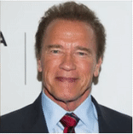
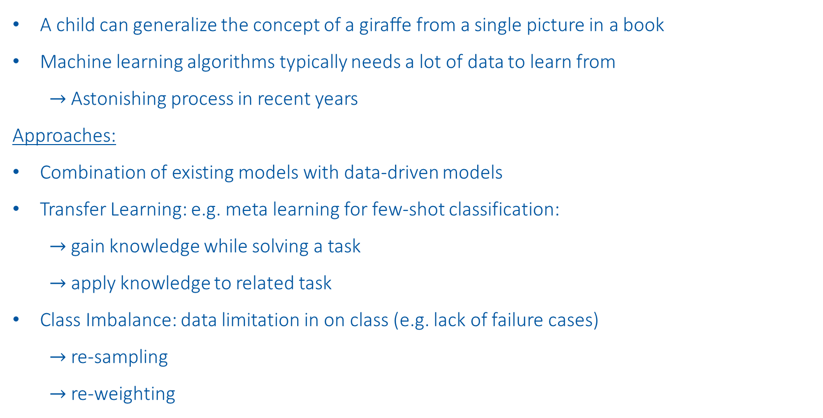
3. Data-Driven Models for Data Limitation
A child can generalize the concept of a giraﬀe from a single picture in a book
Machine learning algorithms typically needs a lot of data to learn from
$→$ Astonishing process in recent years
Approaches:
Combination of existing models with data-driven models
Transfer Learning: e.g. meta learning for few-shot classification:
$→$gain knowledge while solving a task
$→$apply knowledge to related task
Class Imbalance: data limitation in on class (e.g. lack of failure cases)
$→$ re-sampling
$→$re-weighting
Source Picture
Source Video
Prediction
A. Siarohin et al., “First Order Motion Model for Image Animation”, NIPS, 2019

Slide 12
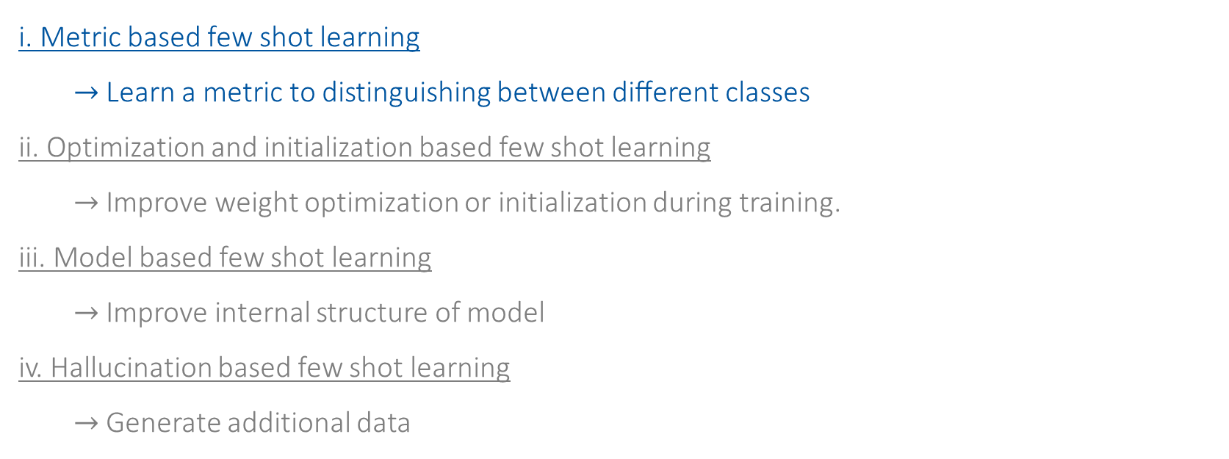
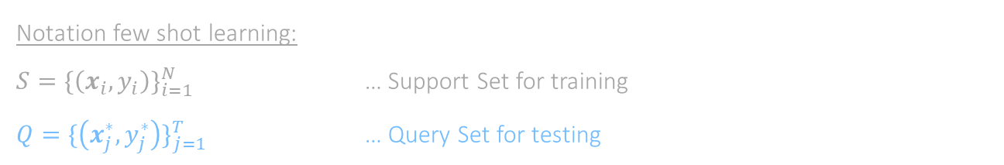
4. Few Shot Learning Algorithms
i. Metric based few shot learning
$→$Learn a metric to distinguishing between diﬀerent classes
ii. Optimization and initialization based few shot learning
$→$Improve weight optimization or initialization during training.
iii. Model based few shot learning
$→$Improve internal structure of model
iv. Hallucination based few shot learning
$→$Generate additional data
Notation few shot learning:
$S=\{\left(x_{i},y_{i}\right)\}_{i=1}^{N}$ … Support Set for training
$Q=\{\left(x_{j}^{∗},y_{j}^{∗}\right)\}_{j=1}^{T}$ … Query Set for testing

Slide 13
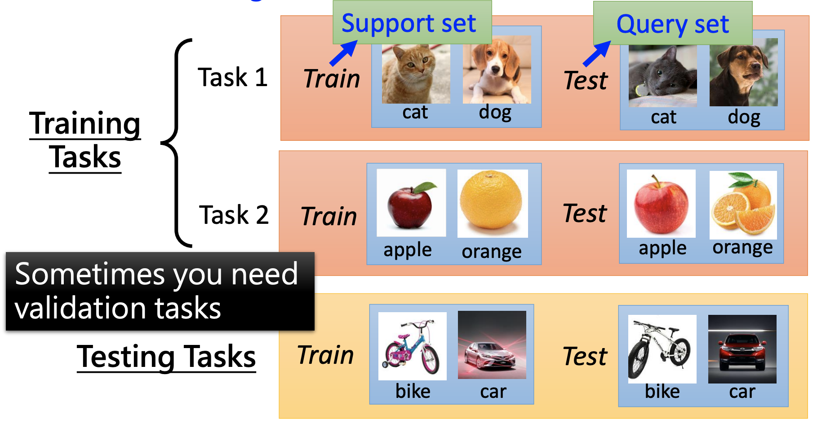
Terminology

Slide 14
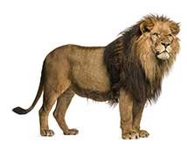
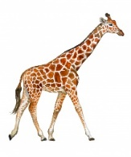
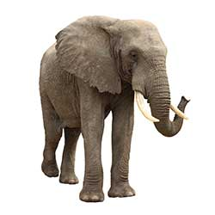
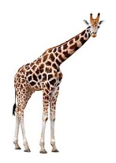
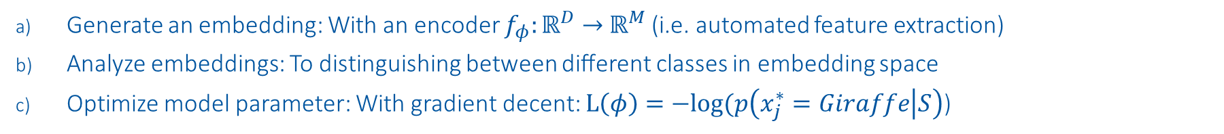
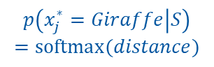



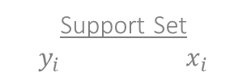
5. Metric Based Few Shot Learning
Support Set $y_{i} x_{i}$
Query Set
$$x_{j}^{∗}$$
Embedding Space
Class Probabilities
Lion
Lion
$$f_{φ}$$
Elephant
Elephant
$$p\left(x_{j}^{∗}=Giraffe | S\right)$$
$$=softmax(distance)$$
$$distance$$
Giraffe
Giraffe
Generate an embedding: With an encoder $f_{φ}:ℝ^{D}→$ $ℝ^{M}$ (i.e. automated feature extraction)
Analyze embeddings: To distinguishing between diﬀerent classes in embedding space
Optimize model parameter: With gradient decent: $L\left(φ\right)=−log⁡(p\left(x_{j}^{∗}=Giraffe | S\right)$)
J. Snell et al.,''Prototypical Networks for Few-shot Learning'', NIPS, 2017

Slide 15
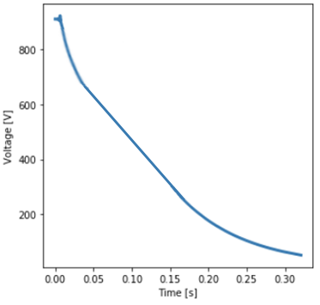
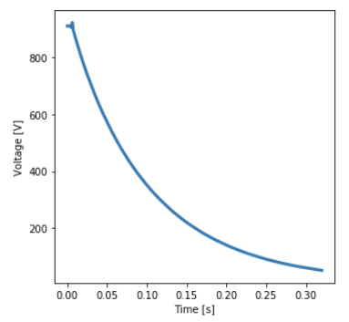
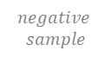
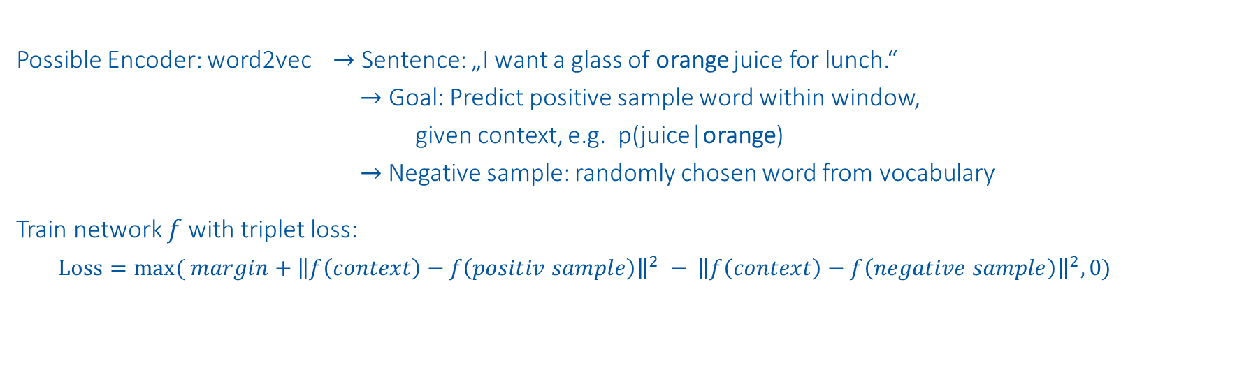
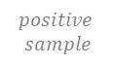

a. Generate an Embedding
window
Output: Embeddings
Possible Encoder: word2vec $→$ Sentence: „I want a glass of orange juice for lunch.“
$→$ Goal: Predict positive sample word within window,
given context, e.g. p(juice|orange)
$→$ Negative sample: randomly chosen word from vocabulary
Train network $f$with triplet loss:
$Loss=max( margin+{\left\|f\left(context\right)−f\left(positiv sample\right)\right\|}^{2} − {\left\|f\left(context\right)−f\left(negative sample\right)\right\|}^{2},0)$
Man
King
Woman
Queen
For time series:
“Sentence”
Random time series
Advantages:
Automatic feature extraction
Suitable for multivariat time series with varying length
Transferability
Disadvantage:
Unsupervised setup
Value of embedding cannot be linked to any physical meaning
$$context$$
$$positive$$
$$sample$$
$$negative$$
$$sample$$
J. Y. Franceschi et al., „Unsupervised Scalable Representation Learning for Multivariate Time Series“, NIPS, 2019
T. Mikolov et al., “Distributed Representations of Words and Phrases and their Compositionality”, NIPS, 2013

Slide 16
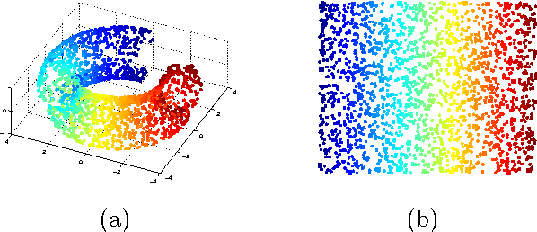
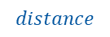
b. Analyze Embeddings
Metrics to analyze distance
Time serie 2
Metrics to analyze distance:
Subtract feature with reference signals
Euclidean distance
Cosine similarity
Dynamic time wrapping
…
Clustering to find centers:
K-Means
DBSCAN
…
Dimension reduction to explore data:
2D t-SNE
PCA
…
Time serie 1
$$distance$$
Time serie 3
Clustering to find centers
Time serie 2
Time serie 1
Time serie 3
Dimension reduction to explore data

Slide 17
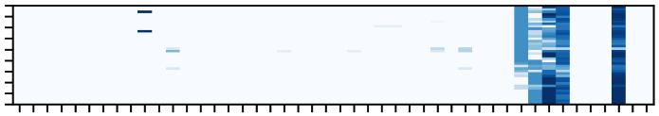
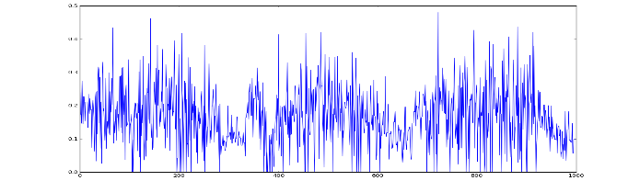
6. How can this be advantageous for our use cases?
Anomalie detection
Train model on reference signals.
Measure distance to other signals.
Investigate signals far away from reference
Find dependencies
Train model on component signals.
Measure distance to other components.
Investigate components close to each other
Failure prediction
Train model on window of existing datapoints.
Measure distance to window of new datapoints.
Investigate signal if change in distance
Reference signals
New signals
Time
Alarms of components
1
2
3
4
Embedding Space
Embedding Space
Embedding Space
Is the component
breaking?
Alarms
component 3
Is this signal
faulty?
Alarms
component 1
4
Is there a known
dependency?
New Signals
Alarms
component 2
1
2
3
L. Felsberger et al., ”Analyzing Failure Mechanism
in Complex Infrastructures”, 2020

Slide 18
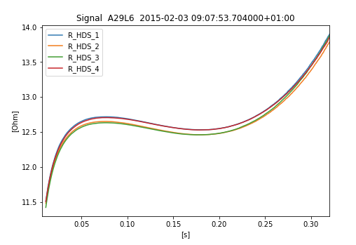
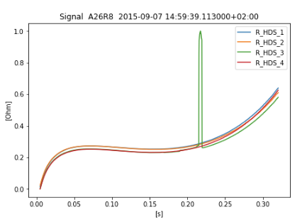


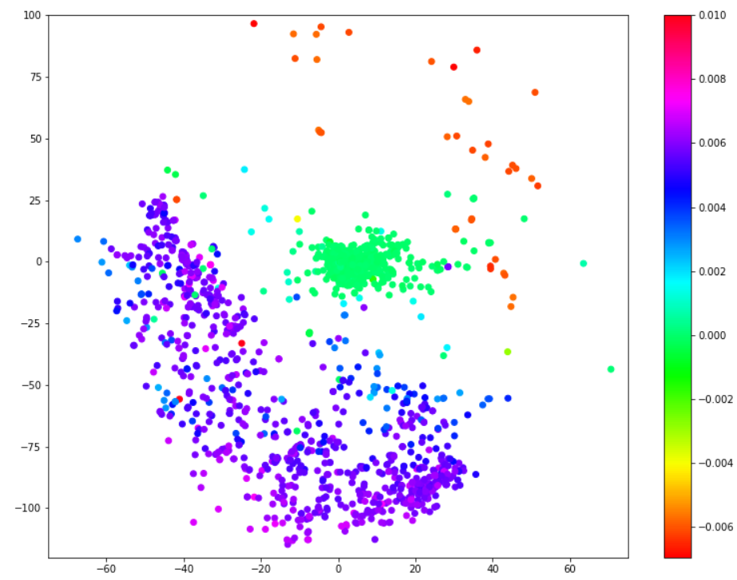
7. Proof of Concept: Analysis of QH discharges
Resistance during QH discharge
Goal: Anomalie detection
Input: Voltage & Current of QH discharges:
Size: 3249 discharges x 8 Signals x 16000 Sample points
Output:
Size of embeddings: 3249 x 160
For Visualization:
2D t-SNE of embeddings
Subtract 2D features by reference
Colorbar: decay start time - decay start time of ref
Depends on the measurement system (QPS, nQPS)
Difficulties:
Unsupervised encoder
No labels necessary, but also no feedback where to look at
Preprocessing heavily effects output
Not only faulty signals are far away from reference
2D t-SNE of embeddings
Faulty Signal!

Slide 19
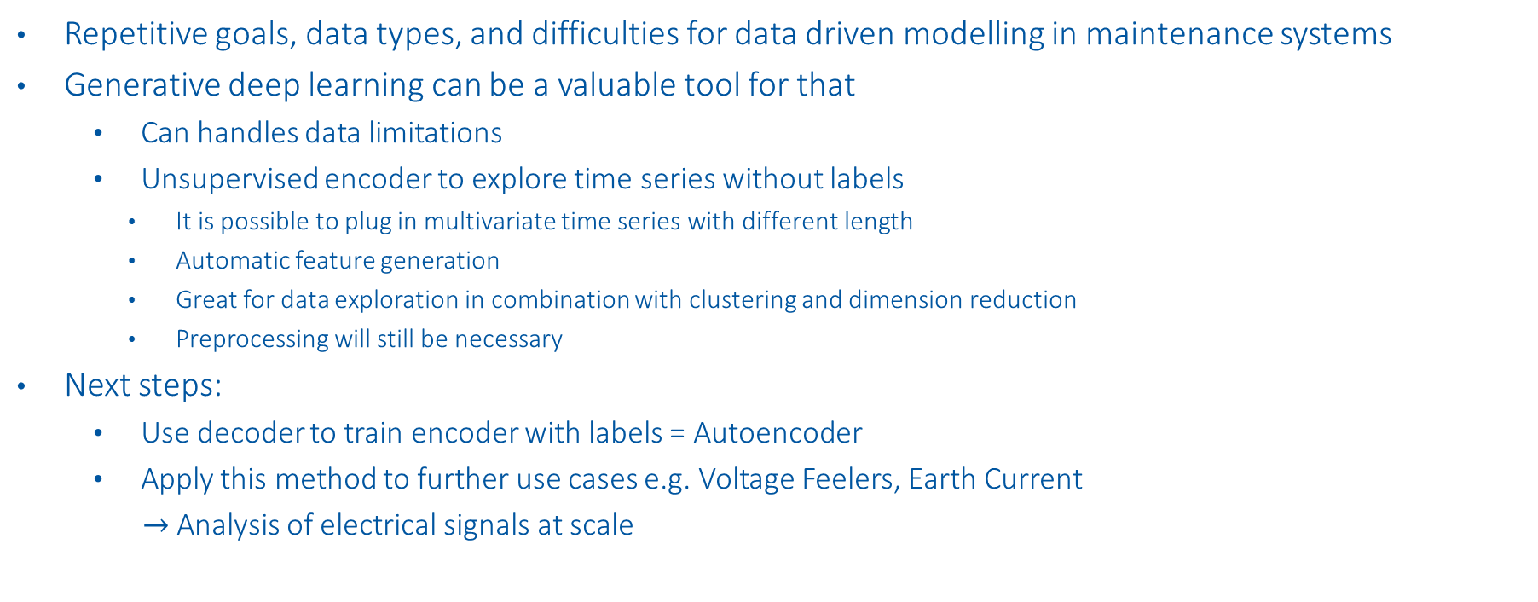
8. Conclusion
Repetitive goals, data types, and difficulties for data driven modelling in maintenance systems
Generative deep learning can be a valuable tool for that
Can handles data limitations
Unsupervised encoder to explore time series without labels
It is possible to plug in multivariate time series with different length
Automatic feature generation
Great for data exploration in combination with clustering and dimension reduction
Preprocessing will still be necessary
Next steps:
Use decoder to train encoder with labels = Autoencoder
Apply this method to further use cases e.g. Voltage Feelers, Earth Current
$→$ Analysis of electrical signals at scale

Slide 20


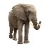
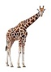


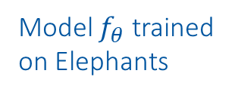
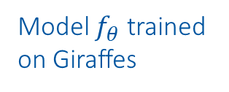


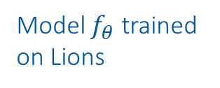
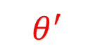
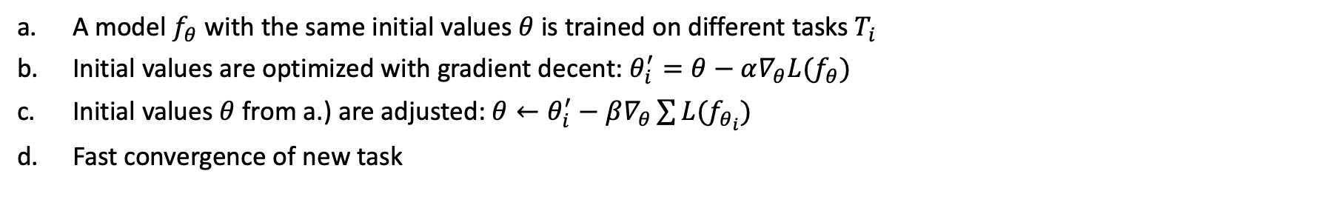




ii. Optimization and initialization based meta learning
A model $f_{θ}$ with the same initial values $θ$ is trained on different tasks $T_{i}$
Initial values are optimized with gradient decent: $θ_{i}^{′}=θ−α∇_{θ}L(f_{θ})$
Initial values $θ$ from a.) are adjusted: ${θ←θ}_{i}^{′}−β∇_{θ}\sum{L(f_{θ_{i}})}$
Fast convergence of new task
a:
b:
c:
d:
$$θ$$
$$θ$$
Model $f_{θ}$ trained
on Lions
Model $f_{θ}$ trained
on Giraffes
Model $f_{θ}$ trained
on Elephants
$$θ$$
$$θ$$
$$θ_{ }^{′}$$
$$θ_{ }^{′}$$
$$θ_{ }^{′}$$
$$θ_{ }^{′}$$
$$θ_{ }^{′}$$
C. Finn, P. Abbeel, and S. Levine, “Model-Agnostic Meta-Learning for Fast Adaptation of Deep Networks,” 2017

Slide 21
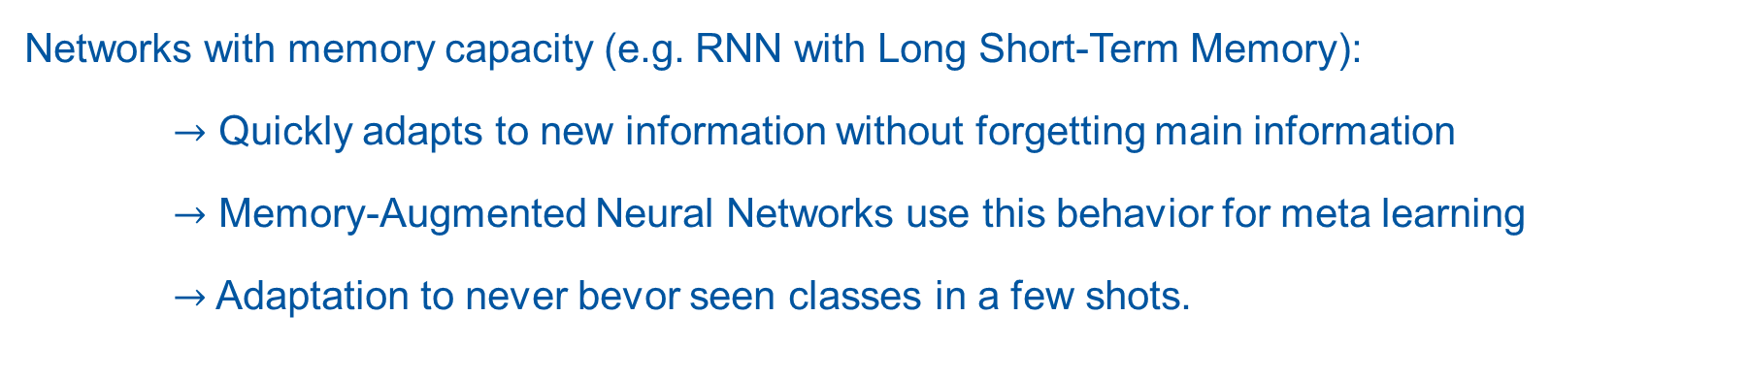
iii. Model based meta learning
Networks with memory capacity (e.g. RNN with Long Short-Term Memory):
$→$ Quickly adapts to new information without forgetting main information
$→$ Memory-Augmented Neural Networks use this behavior for meta learning
$→$Adaptation to never bevor seen classes in a few shots.
A. Santoro, et al.“One-shot Learning with Memory-Augmented Neural Networks,” May 2016
S. Hochreiter and J. Schmidhuber, Long Short-Term Memory. 1997.

Slide 22
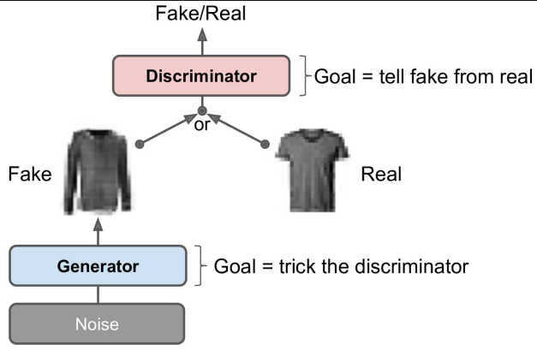
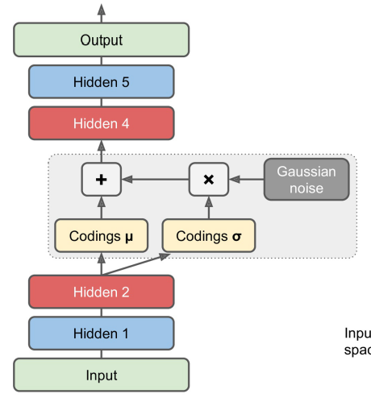
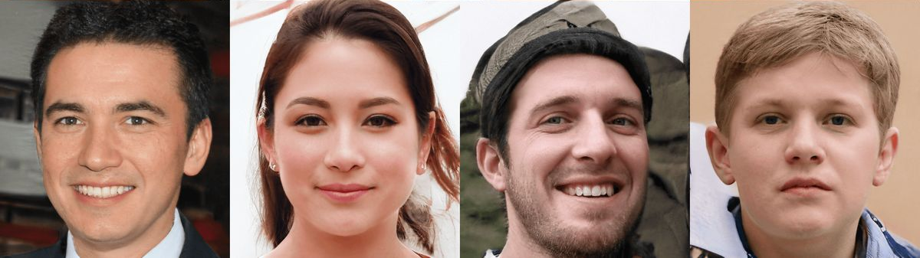
iv. Hallucination based meta learning
The goal is to train a data generator which is able produce artificial data.
Variation Autoencoders
Reduce Dimension
Add noise
Increase Dimension
Generative Adversarial Networks (GANs)
Generator produces artificial data
Discriminator tries to classify between real or fake data
https://thispersondoesnotexist.com/
D. P. Kingma and M. Welling, “Auto-Encoding Variational Bayes,” May 2014
I. Goodfellow, et. al., “Generative Adversarial Nets,” 2014
Géron, Aurélien,"Hands-on machine learning with Scikit-Learn, Keras, and TensorFlow”, 2019
Notes:
Not directly suitable for CERN use cases

